Slide 1


P1074 Adventure Works Project
This Photo by Unknown Author is licensed under CC BY-SA
Presented by
Davkhar Dnyanesha Pradip
POOJA KOTE
Nikhil Bachhav
Tushar Prajapati
Sanjay Biju P
Alok Devanand Lakade
Mallikarjuna KAGULA

Slide 2
Summary of Adventure Works
We Developed an interactive analytics dashboard to monitor sales performance,
customer behavior, product trends, and regional contributions. Enabled data- driven decision-making for sales strategy, inventory optimization, and market expansion. Prepared and transformed data using SQL, including table joins, date standardization, and KPI calculations
Delivered key metrics such as Total Sales, Profit Margin, No. of orders through intuitive visualizations.
Identified top-performing products, seasonal sales patterns, and underperforming regions. Built dashboards using Tableau / Power BI, transforming raw data into clear, interactive visualizations. Implemented dynamic filters and parameters (time period, product category, region) to enable detailed exploration and drill-down analysis.Enabled stakeholders to identify top- performing products, high-value customers, seasonal trends, and underperforming regions

Slide 3


Step By Step Progress
KPI'S List
One by One Solve the kpi's
Excel Dashboard
Create a dashboard using with excel data
Power BI Dashboard
Connect SQL database to Power BI and create a
dashboards.
Tableau Dashboard
Create a adventure works dashboard solve a SQL Queries.

Slide 4

Adventure Works Sales & Performance KPI’s
Total Sales Amount
Total Orders
orders per Day / Month / Year
Sales Growth % (MoM / YoY)
Total Profit
Top-Selling Product
Sales by Region / Territory
Territory-wise Sales Growth
.

Slide 5

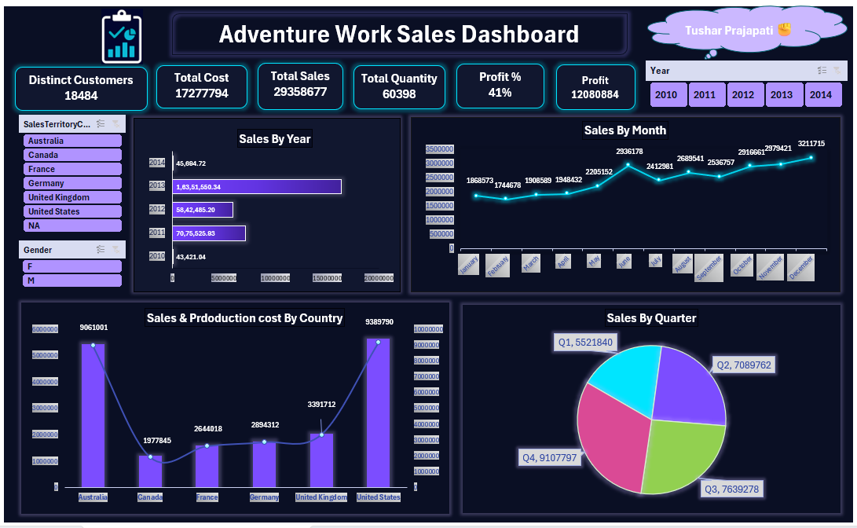
EXCEL Adventure Works DASHBOARD

Slide 6
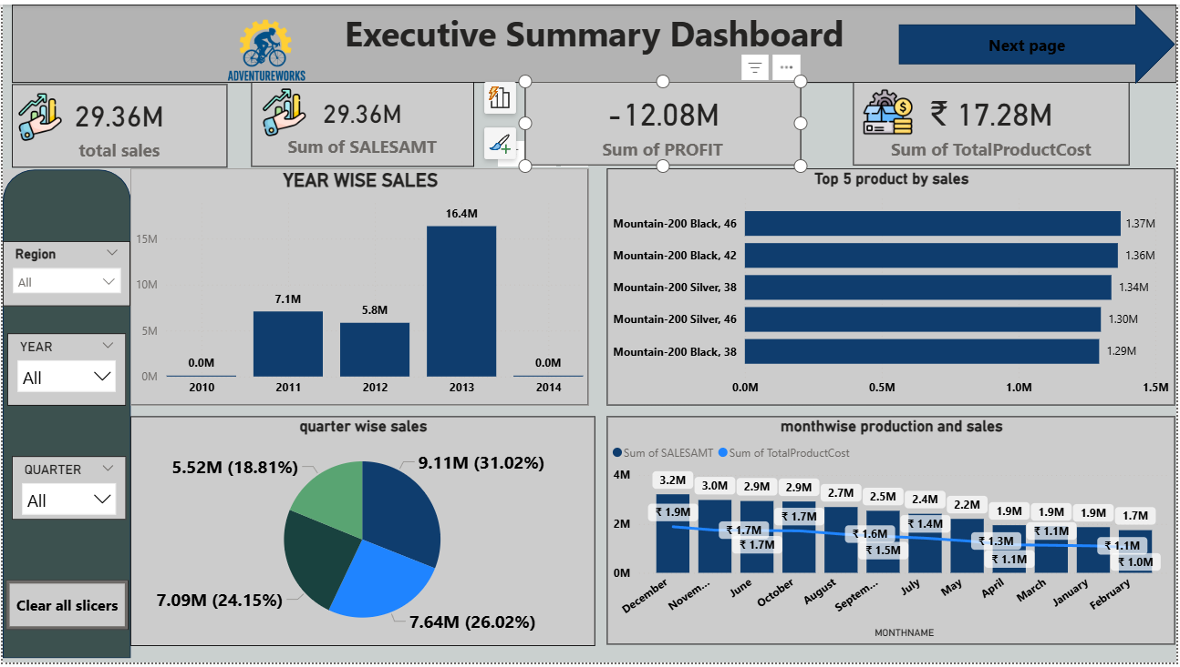
Power Bi Adventure Works Dashboard

Slide 7
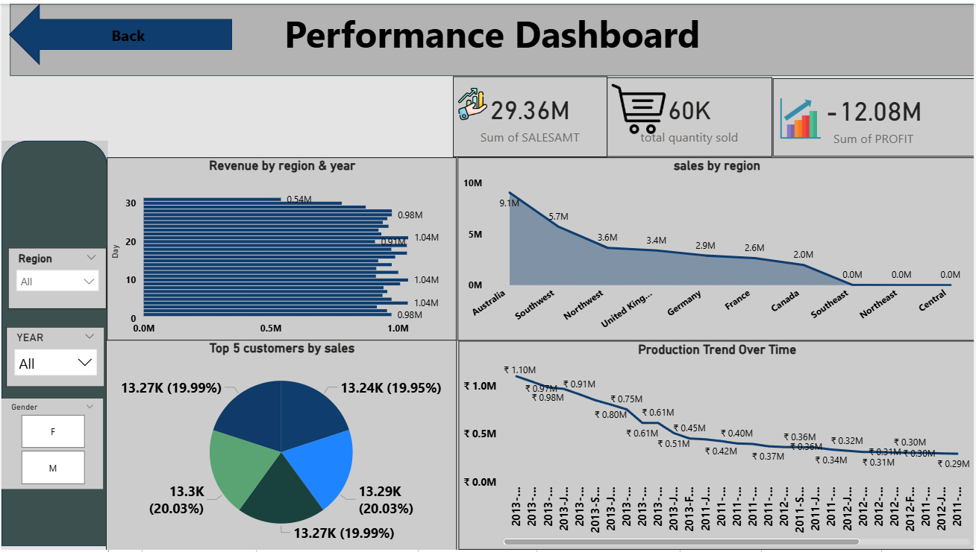
PowerBi Adventure Works Dashboard

Slide 8
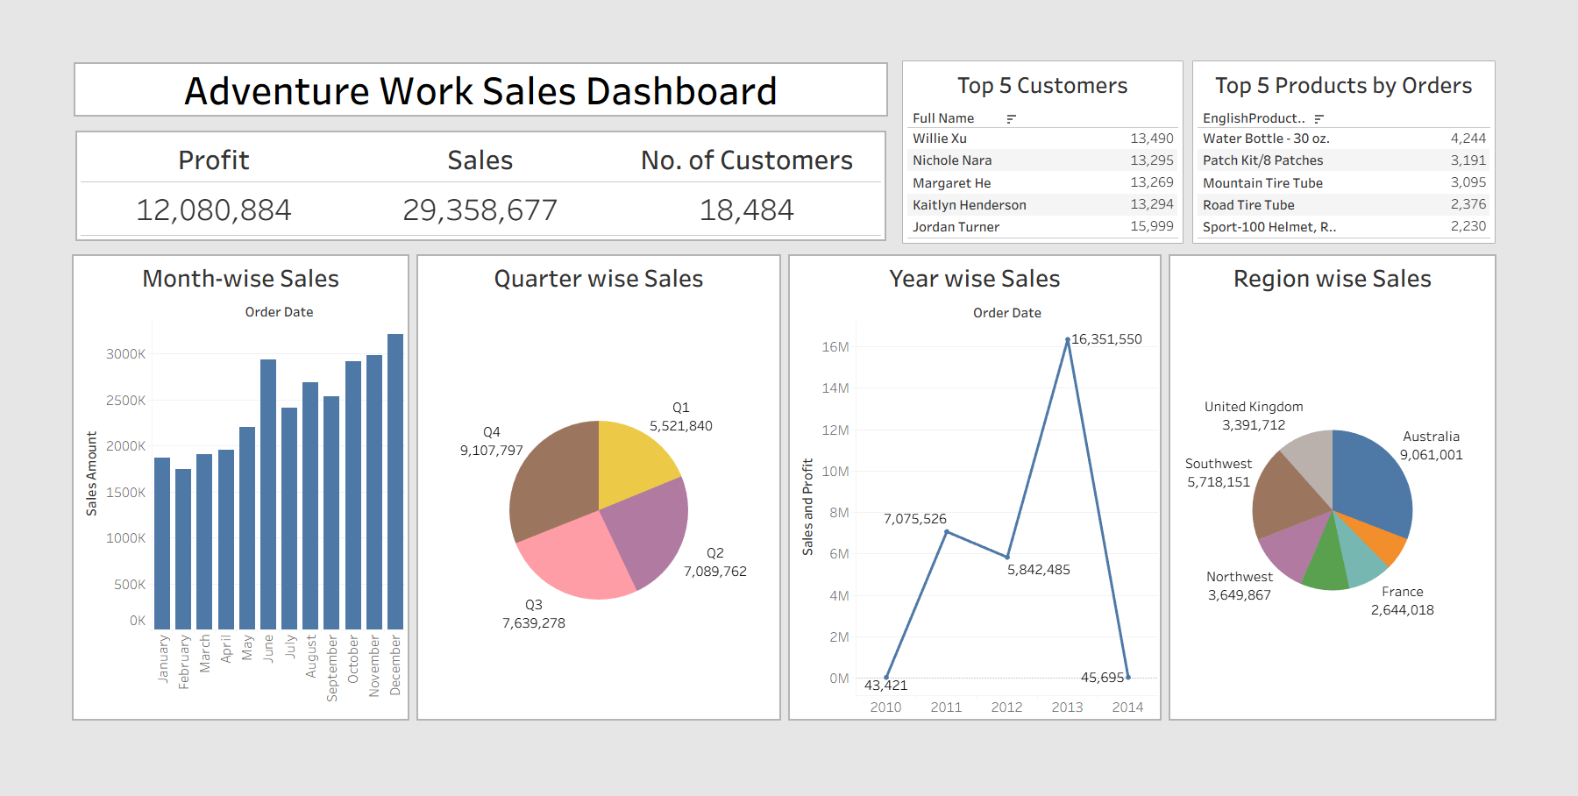
Tableau Adventure Works Dashboard

Slide 9
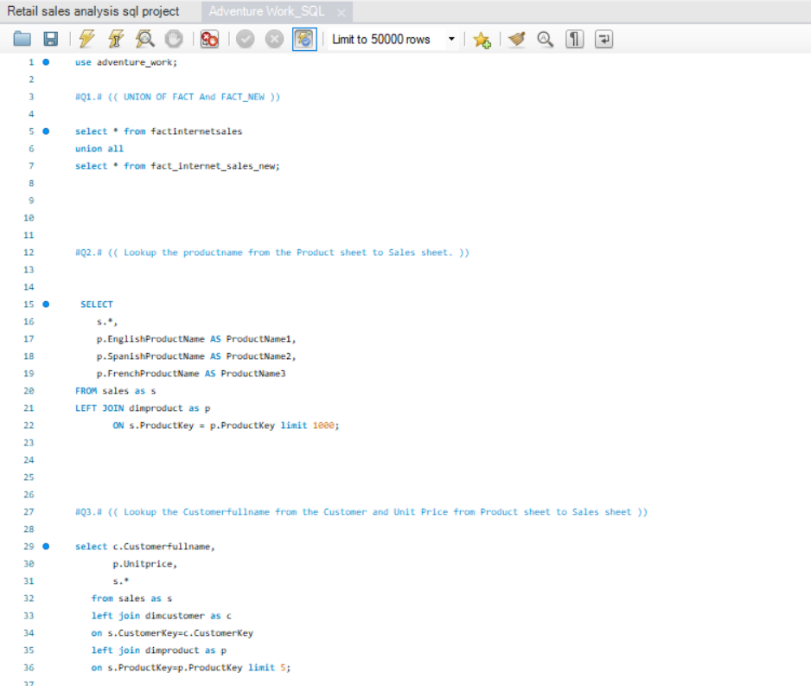
SQL Queries

Slide 10
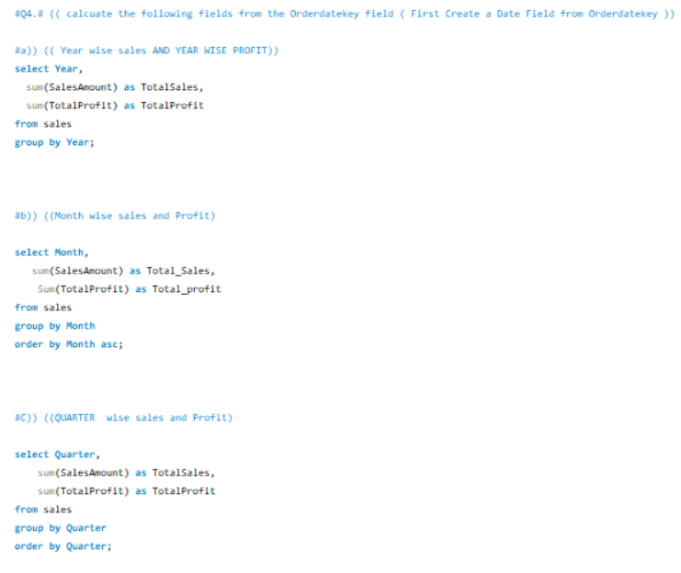
SQL Queries

Slide 11
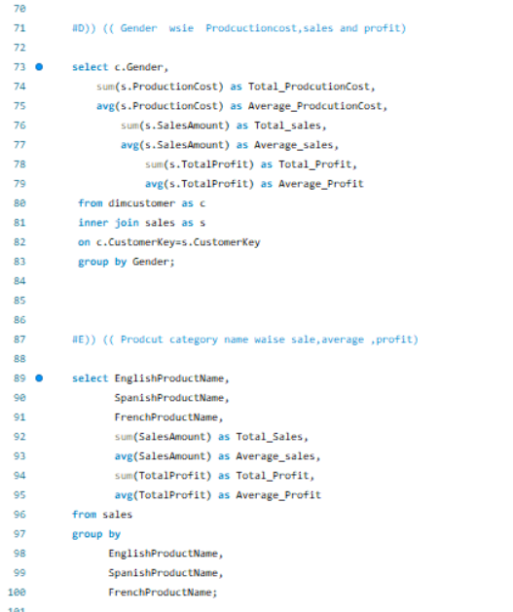
SQL Queries

Slide 12
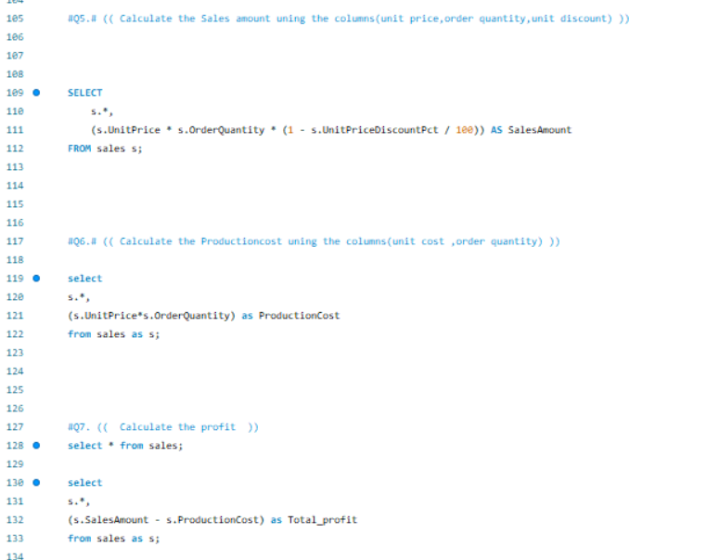
SQL Queries

Slide 13
Key Insights
Revenue Leaders: Certain regions and product categories contribute most to overall sales.
High-Value Customers: A small customer segment drives a large portion of revenue.
Top Products: Best-selling products dominate revenue; underperforming items highlight opportunities.
Profitability Focus: High-margin products and regions outperform others; optimizing costs can boost profits.
Growth Opportunities: Emerging product lines and regional trends provide actionable business strategies.

Slide 14
Conclusion
The Adventure Works project analyzed sales and customer data to identify key business trends. Regional analysis showed that some territories outperform others, indicating opportunities for targeted market expansion. Additionally,
certain products generate high suggesting the need for pricing
sales
and
volumes but lower profit margins, discount optimization. . Interactive
dashboards enabled data-driven decisions for improving profitability and regional performance.

Slide 15

Thank you!

